Slide 1
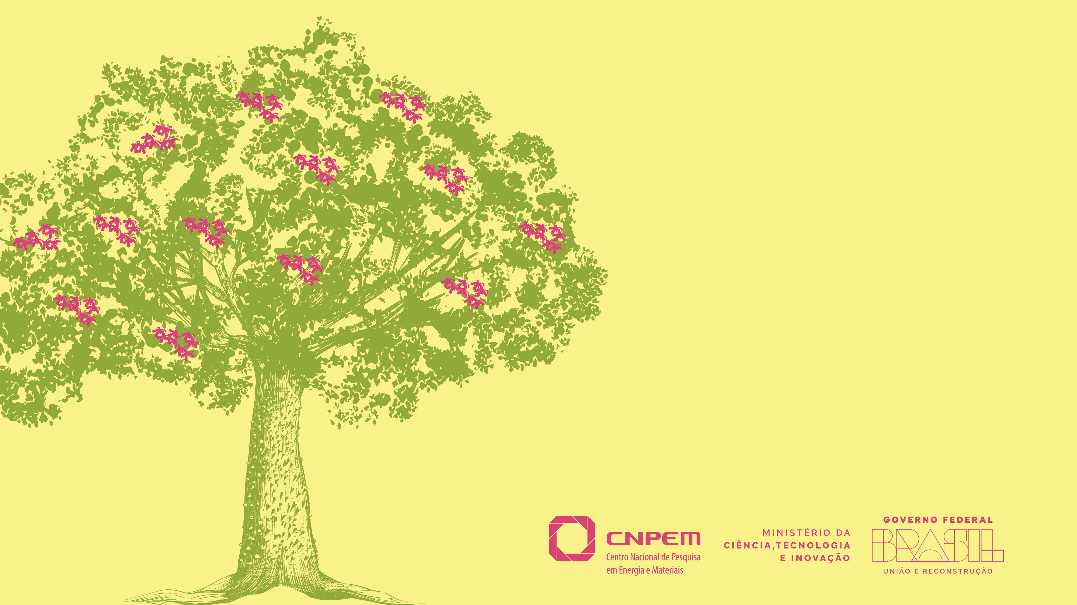
Paineira Graphical User Interface (Iguape) - Tutorial

Slide 2
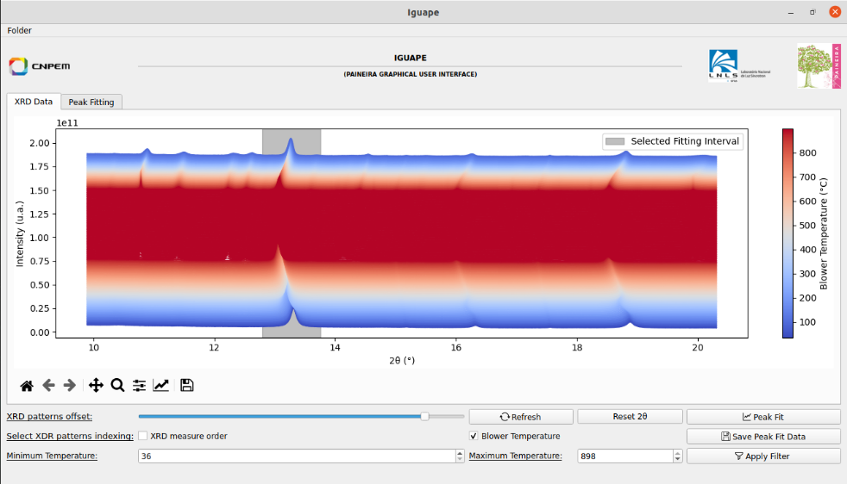
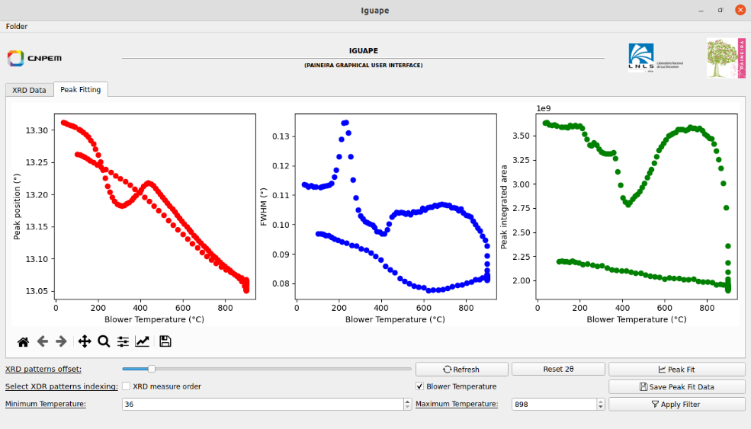
Introduction: A Python based GUI for visualization and processing of XRD data
Iguape is a Graphical User Interface (GUI) for kinetic experiments at Paineira. It displays, in real-time, the XRD patterns obtained during an in-situ experiments at Paineira.
The software was written in Python, making use of various libraries to exhibit and process the XRD data.
This document offers a brief tutorial, for first-time users.

Slide 3
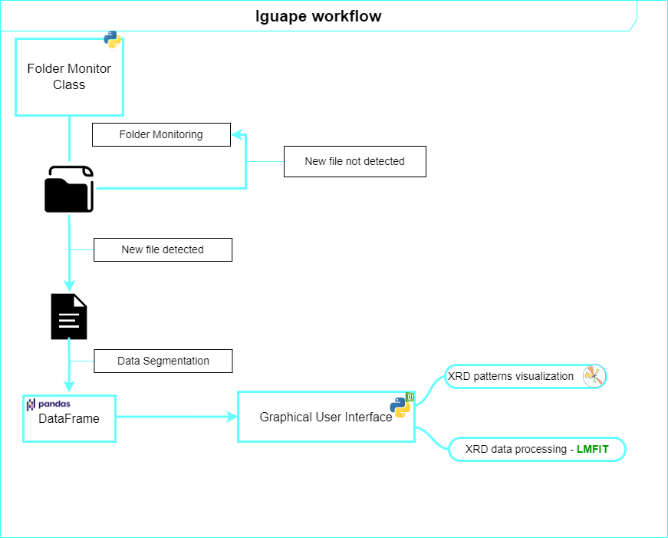
Introduction: A Python-based GUI for visualization and processing of XRD data
Iguape operates by monitoring the folder where the MERGE files are stored. Once a new file is detected, Iguape stores the new XRD data and keeps looking for new files, until a stoppage tag, embedded in the Paineira acquisition script is given to the monitor class.
Iguape
Folder Monitor Class
File Detection
Data Segmentation
GUI
Data Visualization
XRD Data Processing

Slide 4
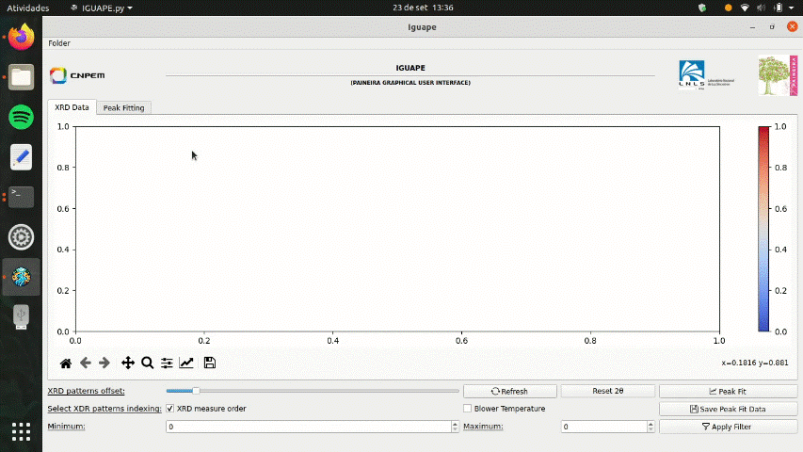
Initialization
Iguape can be accessed via Paineira Utils GUI or typing iguape (lower case) in the command terminal.
When using the Windows-based computer, Iguape can be found in the desktop, and a double-click will open the program.
Once Iguape is initialized, you’ll need to select the merge_files folder of your experiment. Inside this folder, there should be a file called iguape_fileslist.txt, from which the Folder Monitor Class tracks the XRD data to be plotted. This file is of utmost importance and MUST NOT be deleted under any circumstance.

Slide 5
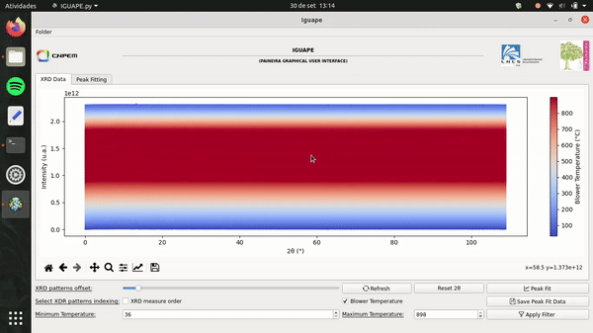
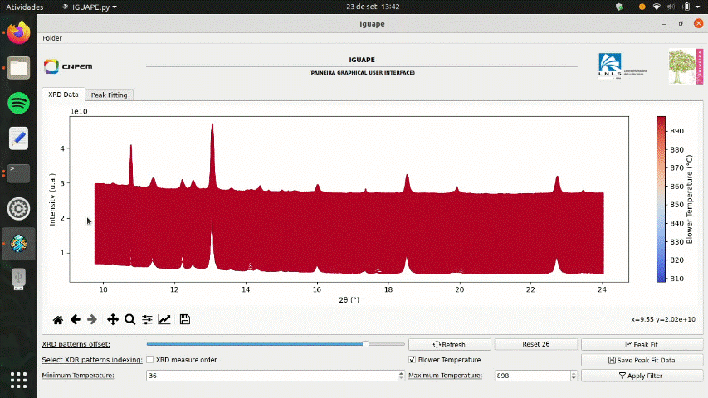
Operation: Common routines and features Figure Customization
Iguape offers various types of customization
Offset increase/decrease between the XRD patterns. When the in situ experiment reaches hundreds of XRD patterns it is necessary to change the offset to see the diffraction patterns.
2θ interval mask: with a click and drag in the figure region, a red shade will appear that defines a mask in the 2θ interval. The Pimega 450D has a total angular coverage of 108.9° which sometimes exceeds the region of interest for analysis.
Matplotlib tools for customizing your figure: zoom, span, legend adjustment, etc.
Temperature/Measure Order mask. The user can select an interval of temperature/measure order to be displayed in the main figure. This is great for separately analysis of different experiment stages.

Slide 6
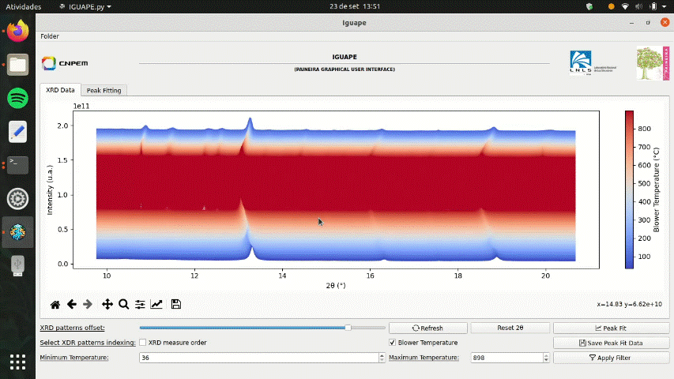
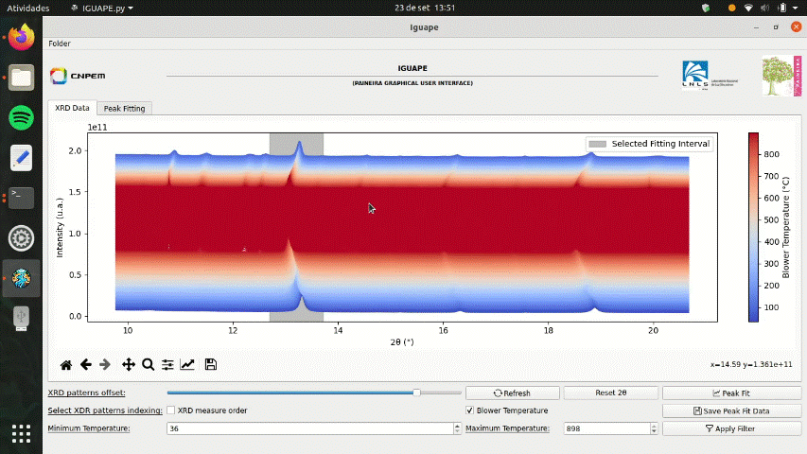
Operation: Common routines and features Peak Fit
XRD data peak fitting
The program can perform peak fitting in a selected 2θ interval. To initiate this feature the Peak Fit button needs to be pressed. A new window will be opened, and the user will be able to display up to two XRD pattern to decide the 2θ fitting interval. This interval is selected with a span tool, i.e., a click and drag feature (just like the 2θ mask) that displays a red shade which defines the interval. The Peak Fit Window has a preview feature that displays the best fit with the chosen model. Once peak fitting is completed, the data will be displayed at the Peak Fitting tab.

Slide 7
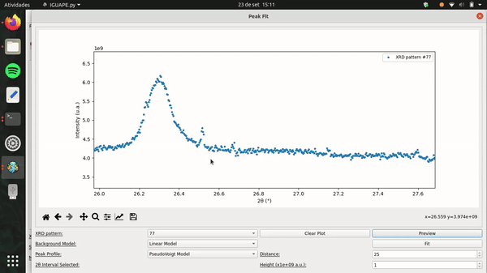
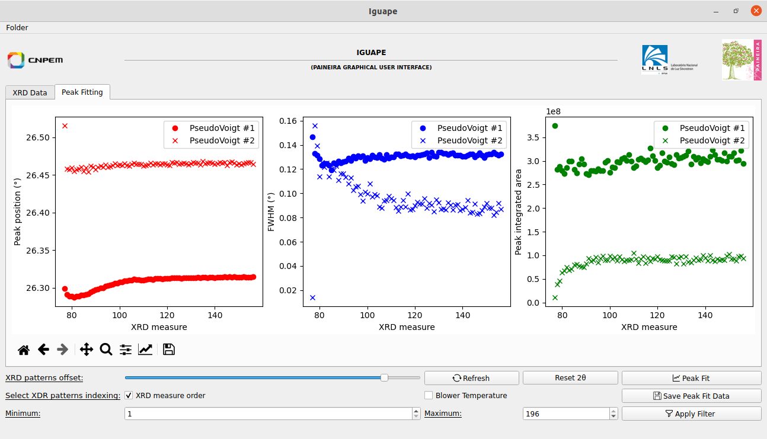
Operation: Common routines and features Peak Fit – part. II
XRD data peak fitting – part. II
The minimum distance (in experimental points) and height between the diffraction peaks can be selected bottom right of the Peak Fit Window.
As the GIF shows, the predefined distance of 25 experimental points is not enough for the blue XRD pattern, and so Iguape cannot find the second diffraction peak. Once this distance is altered to 35 points, the program can make the correct fit.
Iguape can handle the analysis of two diffraction peaks. In this example, the smaller diffraction peak becomes more resolved as the experiment progresses.
The results are exhibited at the Peak Fitting tab.

Slide 8
Final Considerations
Iguape can be a powerful ally when performing in situ experiments. The qualitative analysis helps in decision making and evaluation of the experiment.
The program was designed to be as user-friendly as possible, and its operation is quite simple. It is relevant to emphasize that Iguape was made for XRD data obtained at Paineira, which means that even tough users are encouraged to download it in their own computers, the program will only read data acquired at Paineira. If you have familiarity with programming languages and wants to modify Iguape’s script to read other XRD data, feel free to visit the GitHub page, where you’ll be able to download the program’s files.
Please, any enquiries and doubts about Iguape, feel free to address anyone on the Paineira staff.
For suggestion, please contact joao.neto@lnls.br

